Slide 1
C/C++ Programming in a UNIX Environment
CS 3377
Bhanu Kapoor, PhD
Department of Computer Science University of Texas, Dallas, TX bhanu.kapoor@utdallas.edu
Notes Week 03: Part I
1

Slide 2
Reading for Week 05
Chapter 4, 6, and 7 of A Practical Guide to Linux® Commands, Editors, and Shell Programming, Third Edition. Mark G. Sobell.
Chapter 6: The vim Editor
Chapter 7: The emacs Editor
You should be proficient with a text editor. Emacs and vim/vi are text editors available in the Linux domain. These are widely used editors.
2

Slide 3
Next
Emacs
Vim
3

Slide 4
Next
Emacs
Vim
4

Slide 5
Emacs
To start emacs just “call it” typing emacs
$emacs filename
Basic editing in emacs is very intuitive
use arrows, “pg up”and “pg down”to move cursor
use del key to delete
back key to delete backwards
typing insert text at the cursor position
To edit an existing file type
$emacs <name of the file>

Slide 6
Emacs Commands
Only few keyboard commands you need to know, we use the following abbreviations
“C” is the “Control” key
“M” is the “Esc”key
“-” between two letters mean both have to be
pressed simultaneously
Some basic commands
– C-x, C-s - save the file
– C-x, C-c - exit Emacs

Slide 7
Emacs minibuffer
If you look at your screen you see a solid bar in the bottom of your page, underneath this bar is the “minibuffer”
The “minibuffer” is used for the communication
between you and Emacs
emacs prints messages there
you type text that emacs needs to perform a command, you can type commands here
C-x C-w “save as” - you type the new name in the minbuffer
C-x C-f load a new file in Emacs
C-s : search for a string

Slide 8
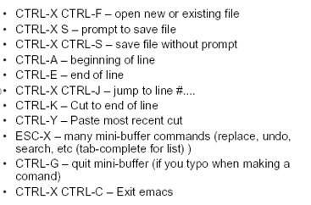
Useful Commands
8

Slide 9
XEmacs
This version of Emacs that has many enhancements specifically for X Window and should be launched locally.
There is a graphical toolbar (like MS Word) for basic options as well as a text driven toolbar for other options.
To invoke XEmacs just type xemacs. If you do not want to tie up the shell, use xemacs&.

Slide 10
Creating and Opening Files
To create a file, type the name of the file that you wish to create after the emacs command. Example: emacs foo.c & or xemacs foo.c & (& optional).
C, C++, HTML, LISP, and other language modes supported.

Slide 11
Emacs Modes
C Mode: Emacs supports C programming with a variety of options in C mode.
C++ Mode: C++ mode also supports the same functions as under C mode, but under the C++ menu.
HTML Mode
Lisp Mode
Look at the Emacs quick reference card!

Slide 12
Next
Emacs
Vim
12

Slide 13
vi, vim, and gvim
vi is a standard editor available on UNIX and LINUX platforms (and others)
vim is “vi improved” and offers additional
features above vi
gvim is “graphical vi improved”, offers additional features above vi and vim, is GUI based, and is more user friendly than either vi or vim

Slide 14
Basic vi
view <filename>
opens the file with vi in Read-Only mode. This is safer and should be used whenever you are merely looking at, and not planning on changing, a file.
Moving around faster:
:N move to the Nth line
:0 move to the first line (go to the top of the file)
:50 move to the 50th line
w move to the next word’s beginning
b move to the previous word’s beginning
CTRL-f moves forward a page
CTRL-b moves backward a page

Slide 15
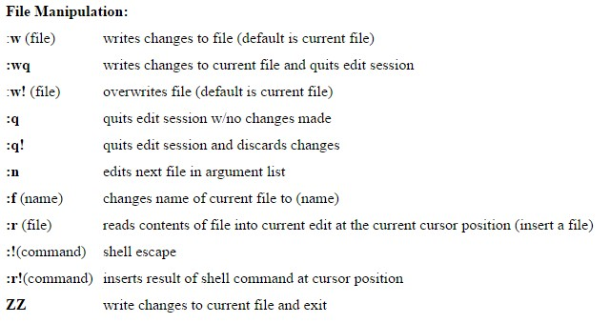
Basic vi: File Commands
15

Slide 16
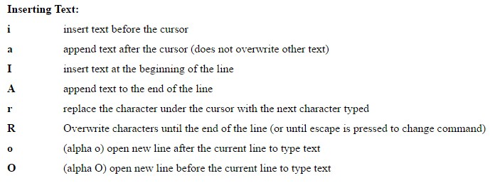
Basic vi: Inserting Text
16

Slide 17
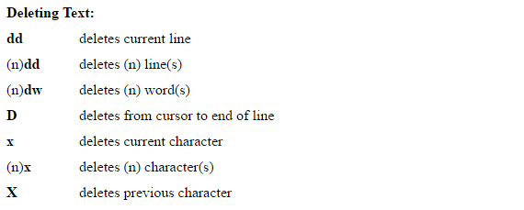
Deleting Text
17

Slide 18
Basic vi: Changing text
Changing text
r<character> replaces current character with the character you type after the “r”. Note this leaves you in command mode.
R<characters> Replaces from the current character onward. Note this leaves you in insert mode until you hit <esc>.
dw
cw
deletes the current word changes the current word.

Slide 19
Basic vi: Repeating Commands
u undoes last command
Repeating commands:
◼ Place a number in front of a standard command:
□ 5j
□ 100k
moves down 5 lines moves up 100 lines
45dd deletes 45 lines (the one you’re on and
the next 44)
3x deletes 3 characters (the one you’re on
and the next 2)

Slide 20
Basic vi
□ :r <filename> This imports the named file onto the line following the cursor. The file is inserted, so the original file below the cursor is moved to be following the inserted file.
:!<shell command> command
:r! <shell command> command into file
. (period) command.
Escape to the shell and issue a
Insert results from shell
This will repeat the last issued
□ CTRL-g Gives information about the file at the bottom of the screen. It will indicate the filename, what line number the cursor is on out of how many lines total in the file, and the percent of the way through the file that the cursor is.

Slide 21
Useful Vi Commands
Replace ALL instances of <old pattern> with
<new pattern> in the file.
:g/<old pattern>/s//<new pattern>/g
To replace ALL instances of <old pattern> with nothing, in effect removing all instances of old pattern, do:
:g/<old pattern>/s///g
Look at the vim quick reference card!

